Slide 1

INFO 440
Wikipedia Edit Histories: How is Truth or Belief “Drafted”?
By Collin Dickerson, Minh Trinh, Han Truong

Slide 2
01
02
03
Table of contents
Project Overview
Methods & Findings
Challenges & Outlook

Slide 3
01
Overview

Slide 4
Overview - Motivation
What does Wikipedia's edit history tell us about how communities find the truth?

Slide 5
Overview – Data and Roadmap
Source: Wikipedia API
Timeframe: Full historical data to identify peak traffic months
Articles Studied:
  Socio-Political: 2026 Iran War, 2026 Lebanon War, Donald Trump, Joe Biden, Hantavirus
  Scientific/Cultural: Artemis II, 2026 in Science, 2026 in Film
Data acquisition
Event-driven edit spikes
Text mining
N-gram and TF-IDF
Comment Similarity Analysis
VADER Sentiment Analysis
POS Tagging
LDA Topics
Raid Keyword Analysis
EDA

Slide 6
02
Models & Findings

Slide 7
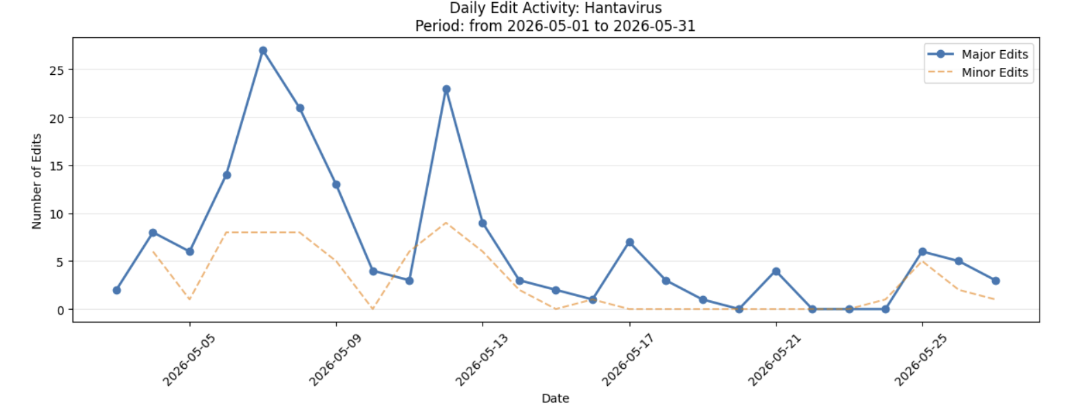
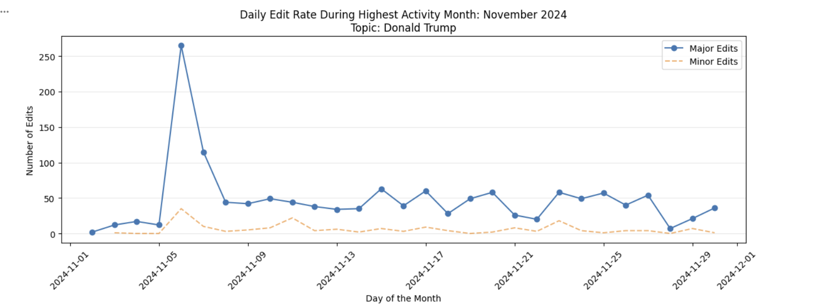
Methods – Edit Spikes
Edit rate analysis in peak months
  Examined major edit rates
Identified spikes in visual analysis
  Hypothesized that secondary spikes indicated controversial topics/ vandalism

Slide 8
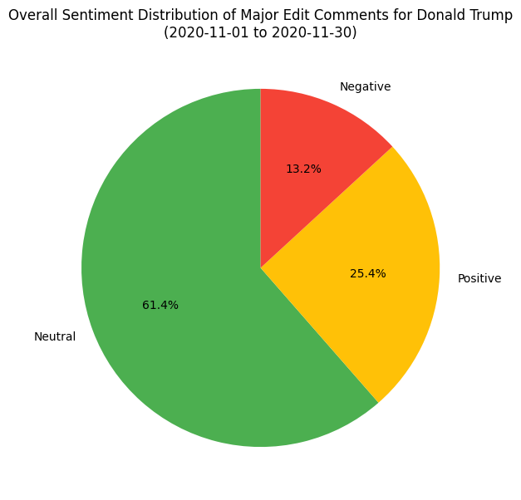
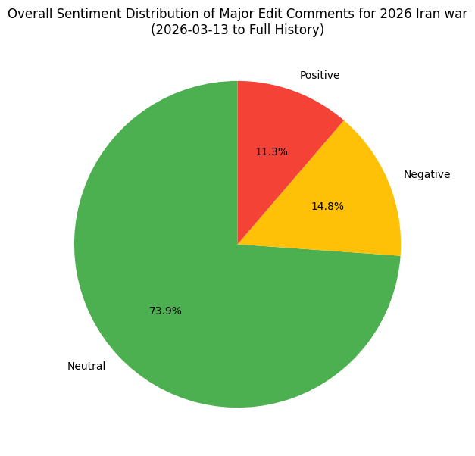
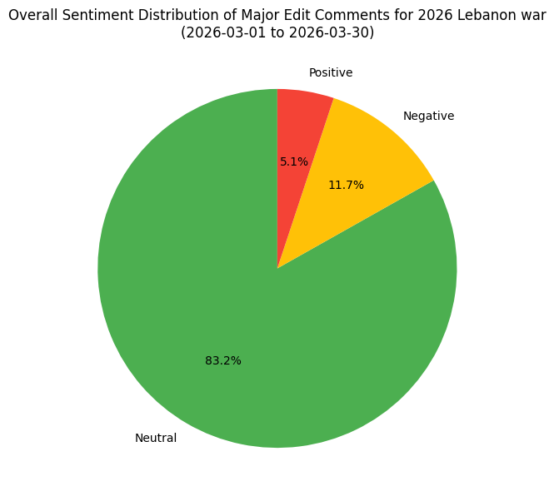
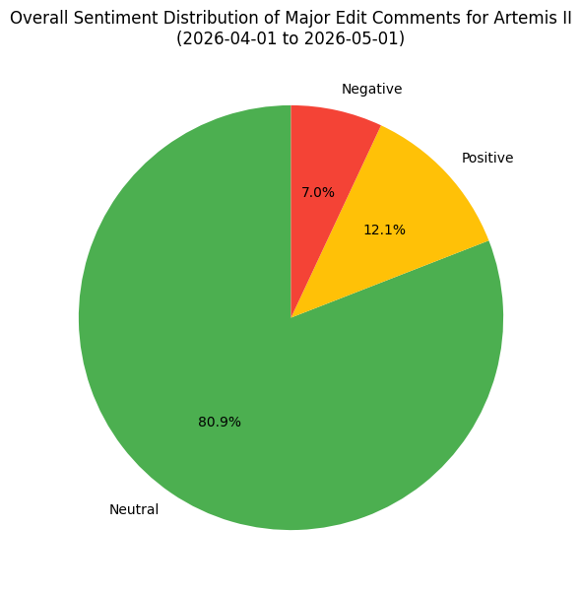
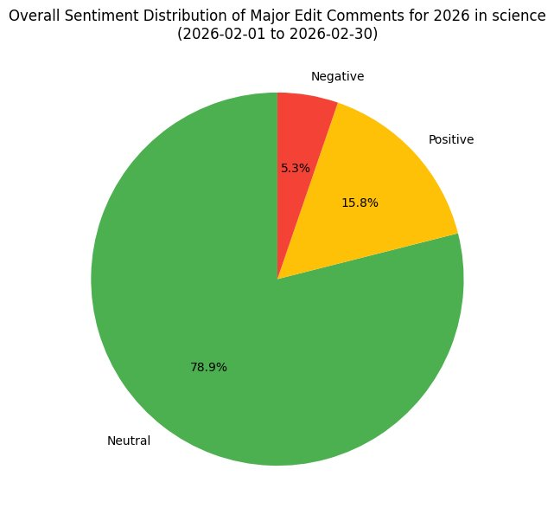
Methods – VADER Sentiment
Political articles show the highest negative sentiment
Scientific topics are more objective and procedural
Although being political/ controversial, 2026 Lebanon war graph looks different
Notes:
Analyze at what points comments are most negative and if they indicate times of vandalism

Slide 9
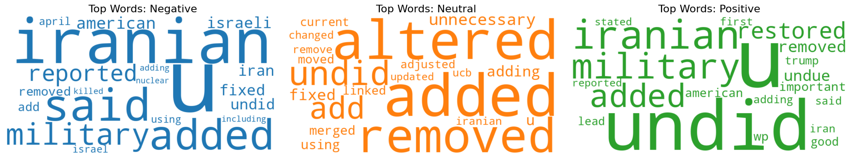
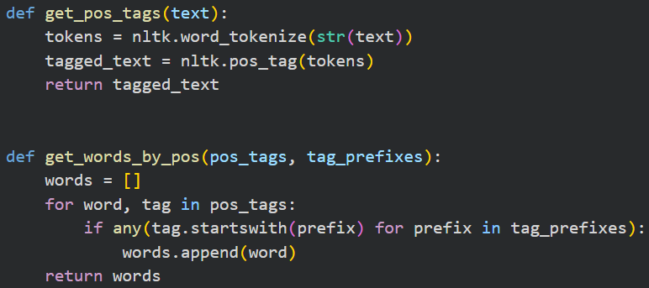
Methods – POS, LDA
Use POS for top 20 words across negative, neutral, and positive sentiment
  Similar words like add/adding/added, fixed, removed, undid
Negative words aren't uniquely raid keywords; just concentrated in controversial articles
  Use LDA to see if we can understand more of what is being commented

Slide 10
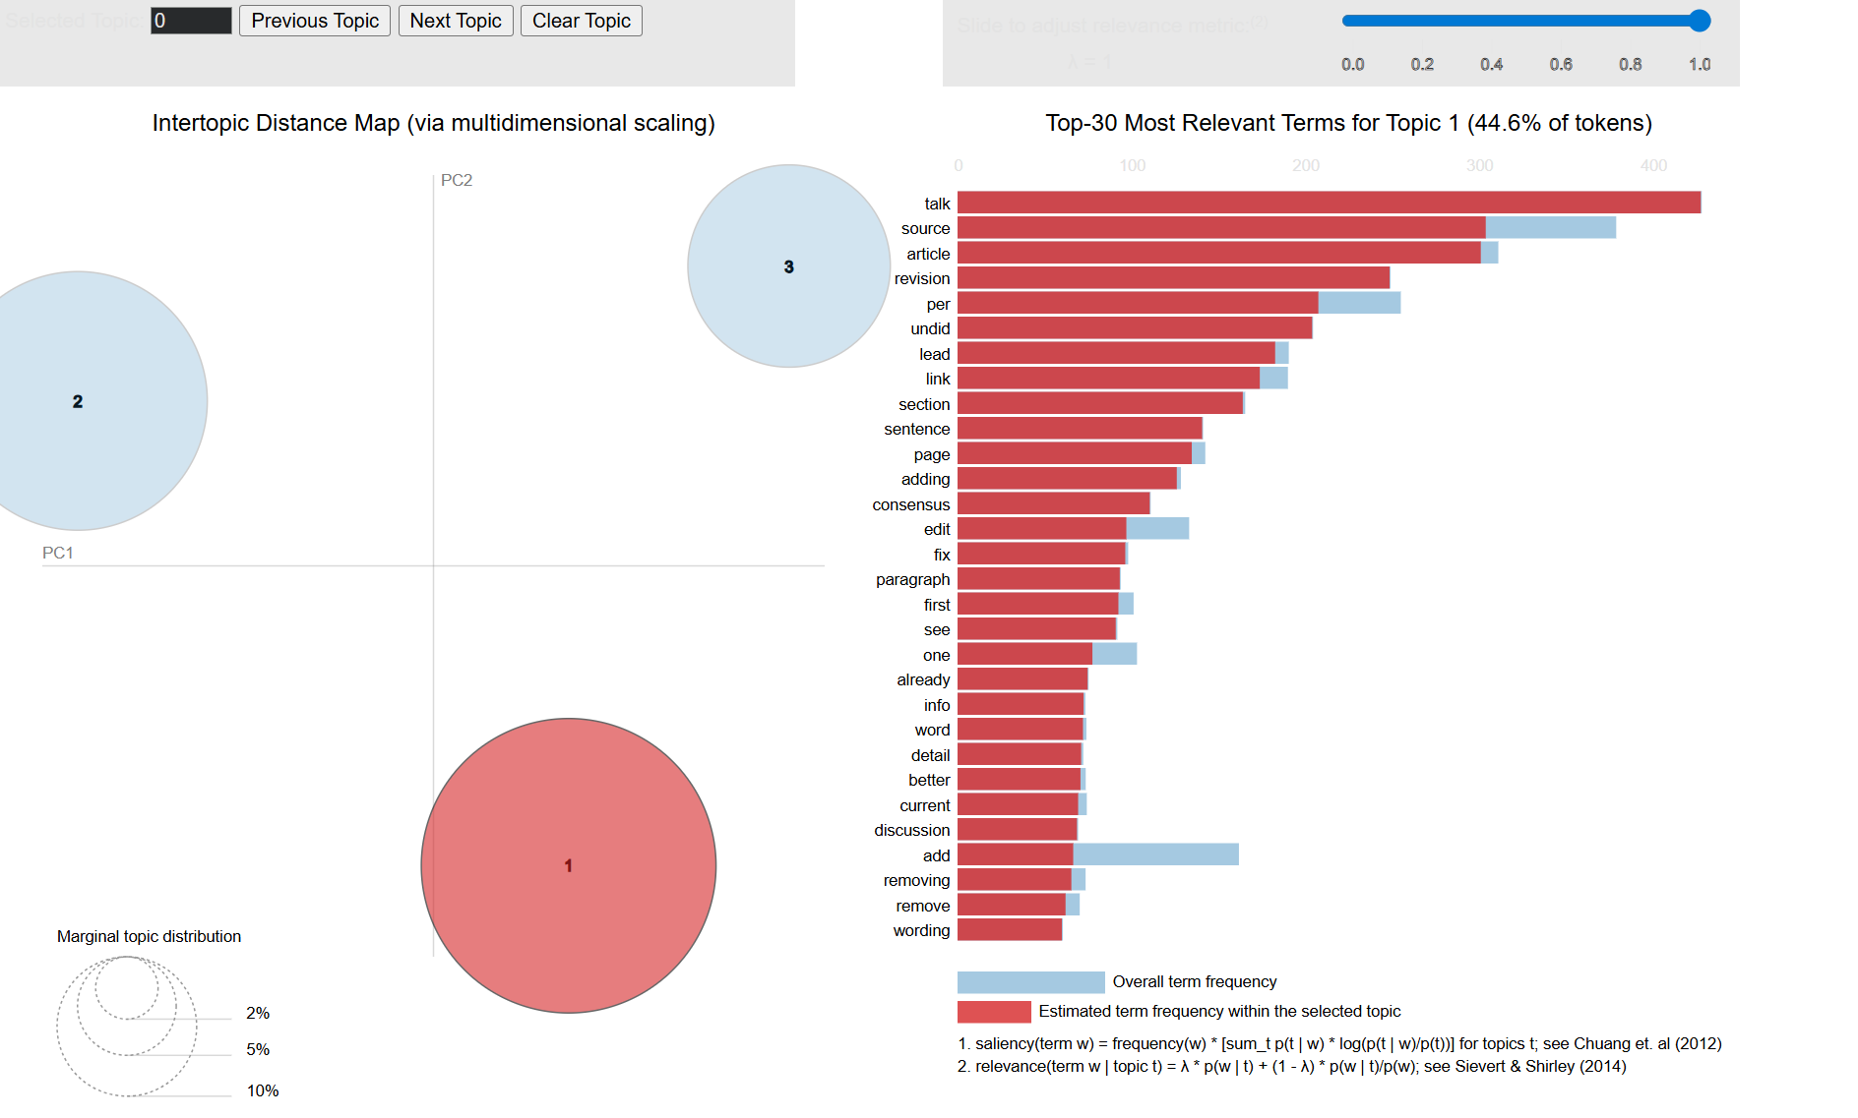
Methods – POS, LDA

Slide 11
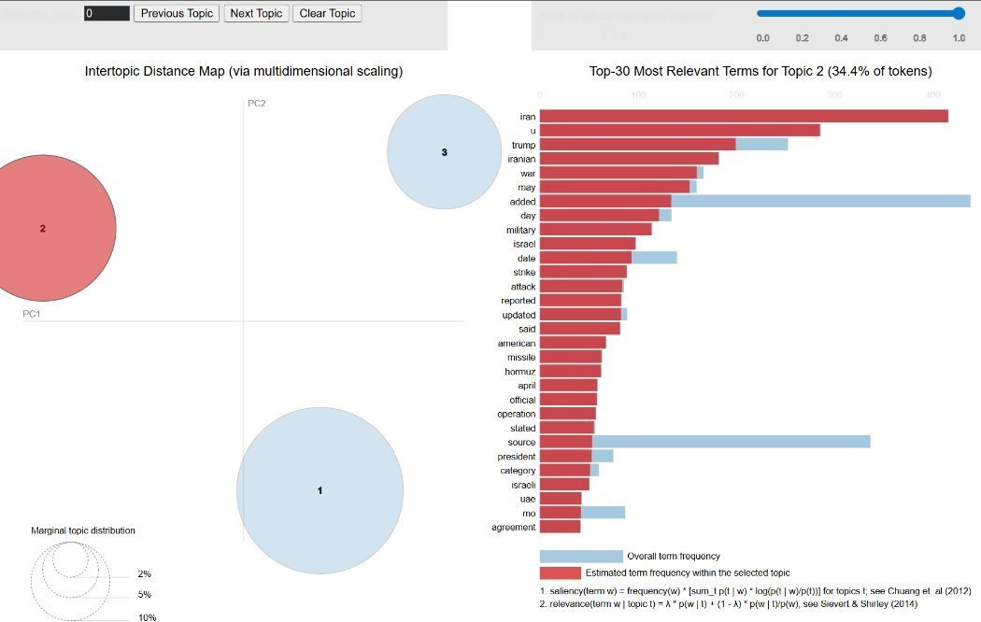
Methods – POS, LDA

Slide 12
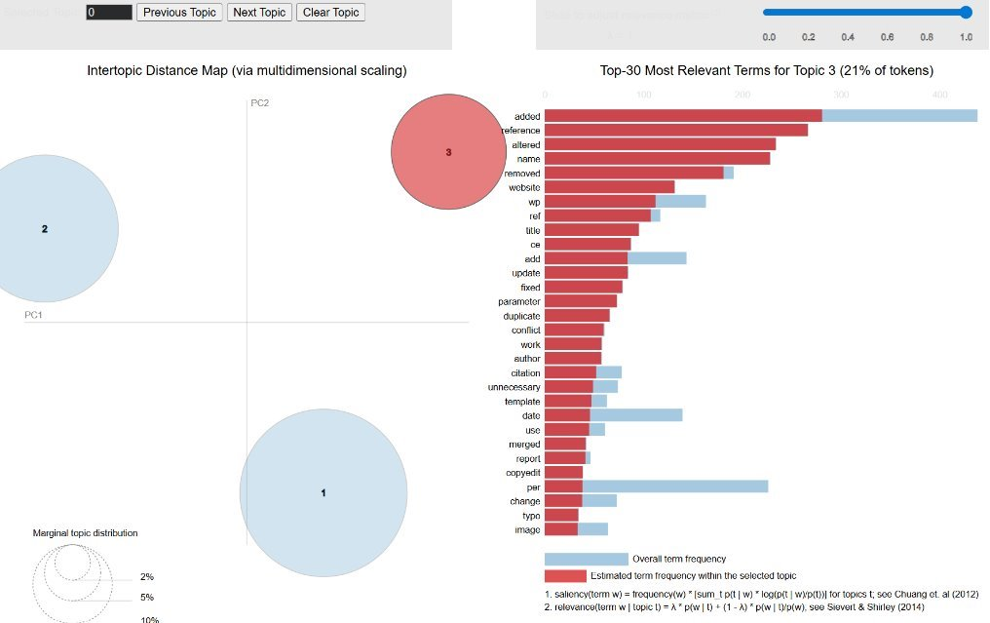
Methods – POS, LDA

Slide 13
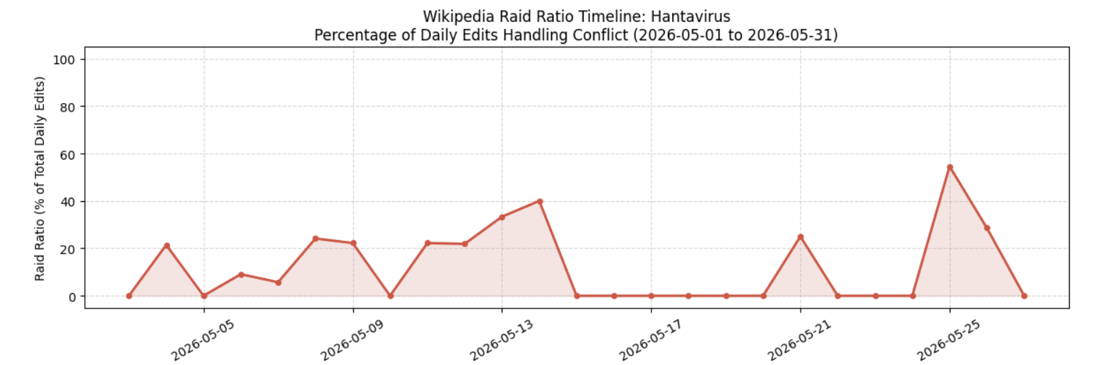
Methods – Raid Keyword Analysis
Found words that indicate vandalism
  revert, undid, rvv, vandal, hoax, fake, disinfo, false, attack
Ran analysis on top months in edit activity for vandalism
  Controversial usually had higher top months
Ran analysis of percentage of vandalism over time
  Saw that vandlism was most present in edit rates spikes
  Especially so in secondary spikes

Slide 14
Findings and Conclusion
Findings​
Conclusions
Controversial articles had higher negative comments
Negative comment sentiment sometimes correlated with edit rates
Raid analysis found that edit rates and raid words activity rose together in secondary spikes
During initial spikes, articles are more likely to be focused on truth finding
However, secondary spikes indicate vandalism
Thus, we concluded that a secondary spike after a first initial spike should indicate vandalism

Slide 15
03
Challenges & Outlook

Slide 16
Challenges
Data Size​
Analysis
Was easy to go beyond scope (forget that edit rates is the core/ tie back)
Had to scrap edit content analysis given said content was pages-long
Had to find controversial articles through research and assumptions
  Had to determine the articles' viability post-analysis
Had to determine raid words after:
  Failing to find unique keywords in top most negative words
  Failing to find a unique topic that was relevant to raids via LDA

Slide 17
Outlook
Learned how to work with an API to pull historical data
Applied various data analytic practices to a large temporal data set
Iterated on own ideas to eventually find a combination of tools that helped form a conclusion

Slide 18
Thank You!
Do you have any questions?

Slide 19
01
Data

Slide 20
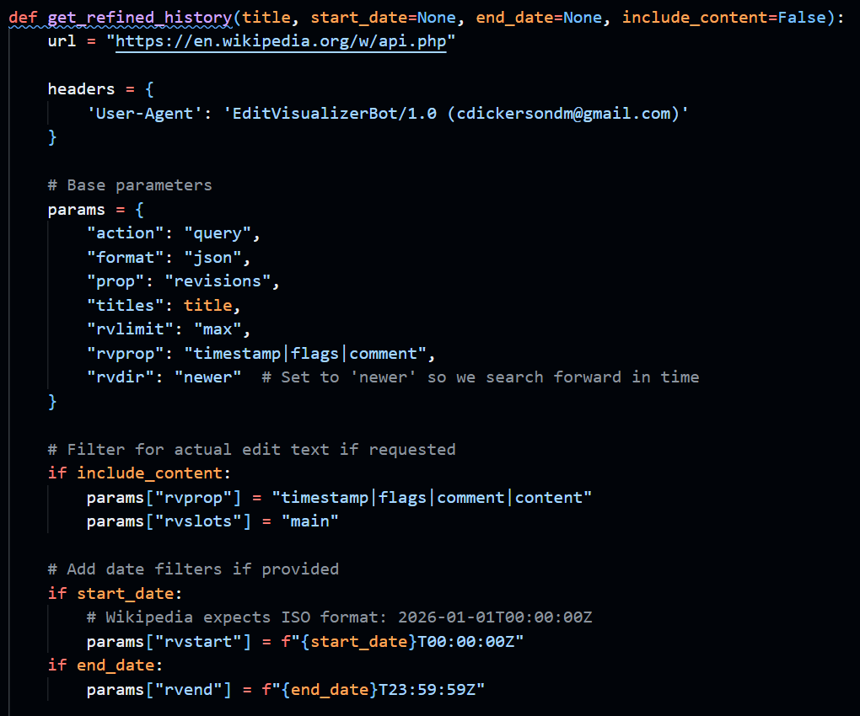
Overview - Data
Wikipedia Edits
Created a function where entering a title and time period retrieves:
  Date edited
  Minor or major change
  Edit comment
  Edit content (include_content = T/F)
Allows for flexibility in choosing what articles to grab information from

Slide 21
Overview - Data
Starting Articles
Focused on a mix of both controversial (recent and past) and non-controversial (event and discovery) articles
Visualizes edit rates of their highest edit month, analyzing edit comments and content
2026 Iran war (Socio-political, Recent);
Donald Trump (Socio-political, Legacy);
Artemis II (Scientific, Event-Driven);
2026 in science (Scientific, Discovery);

Slide 22
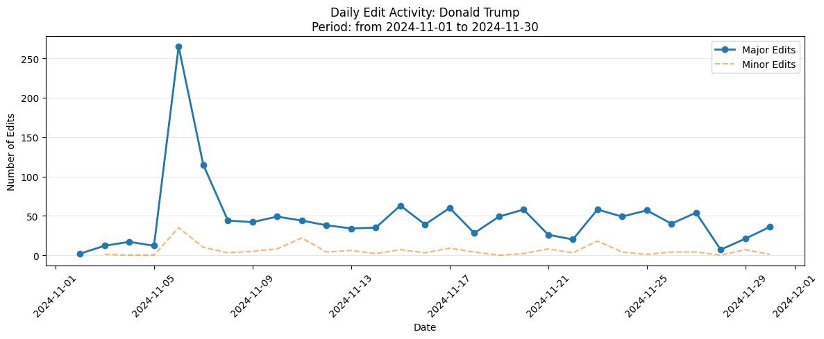
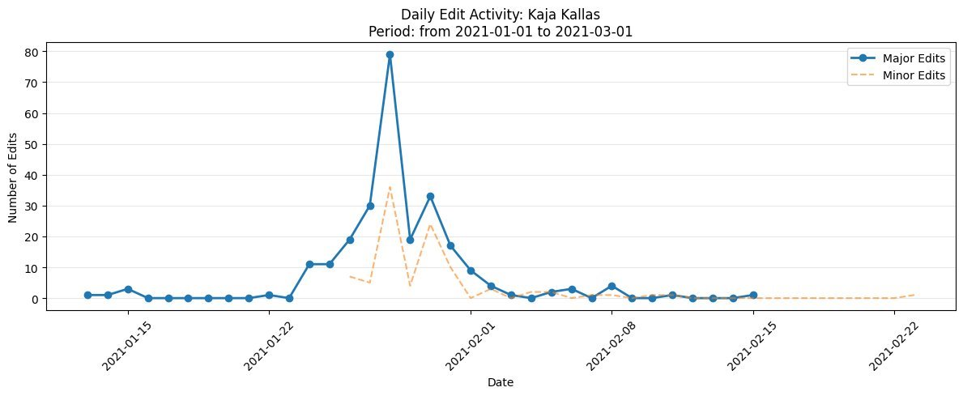
Trend found:
Non- Controversial

Slide 23
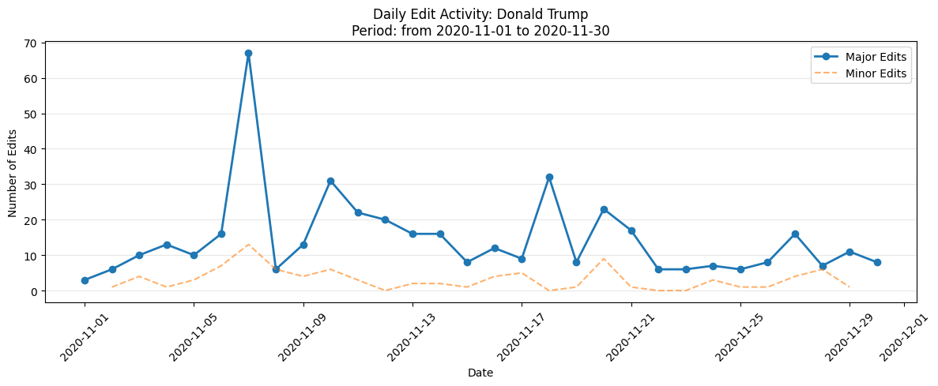
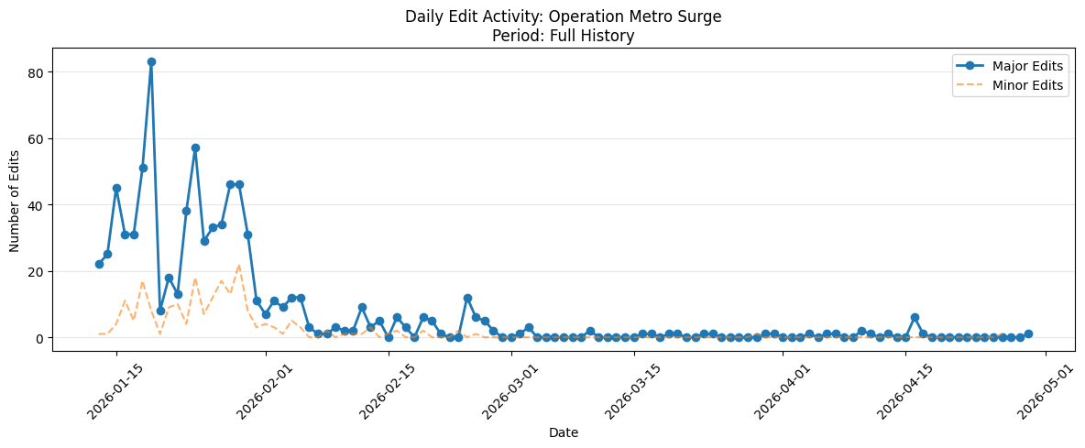
Trend found: Controversial

Slide 24
02
Model

Slide 25
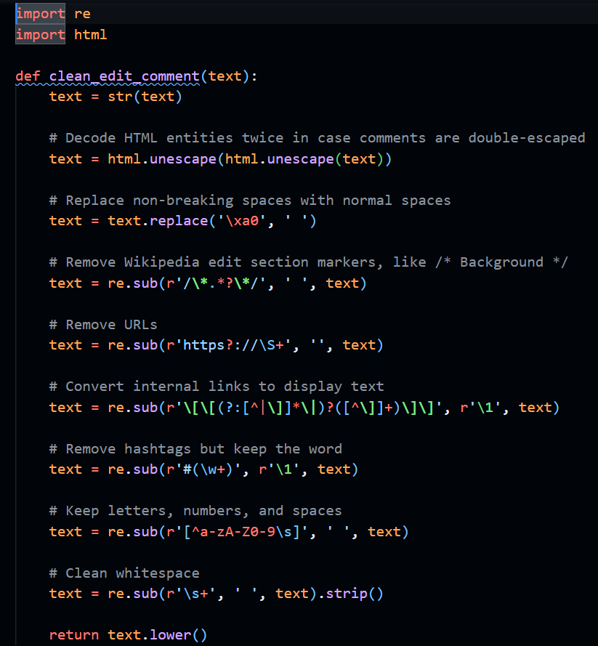
Model
Clean Wikipedia Edit Comments
Created a function that:
  Convert edit comments to Unicode
    nbsp prevents consecutive whitespace characters from collapsing into a single space
  Remove section markers and URL
  Convert internal links to text
    [[LinkText]]
  Keep letters, numbers, and spaces
  Remove # and whitespace

Slide 26
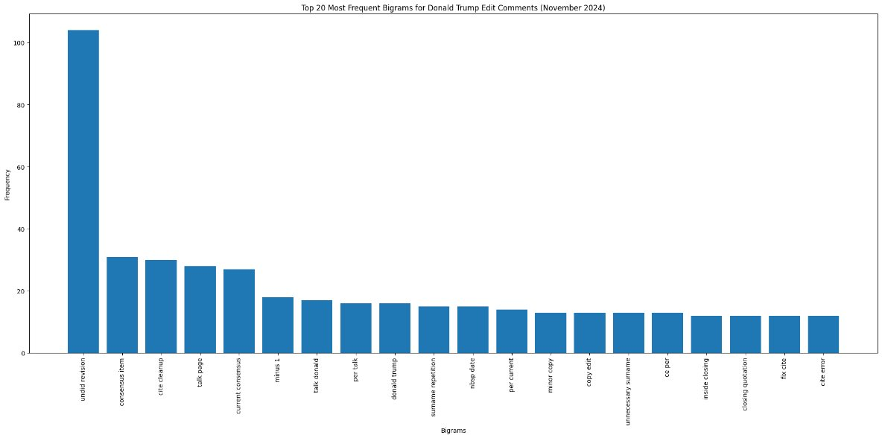
Donald Trump (Nov 2024)

Slide 27
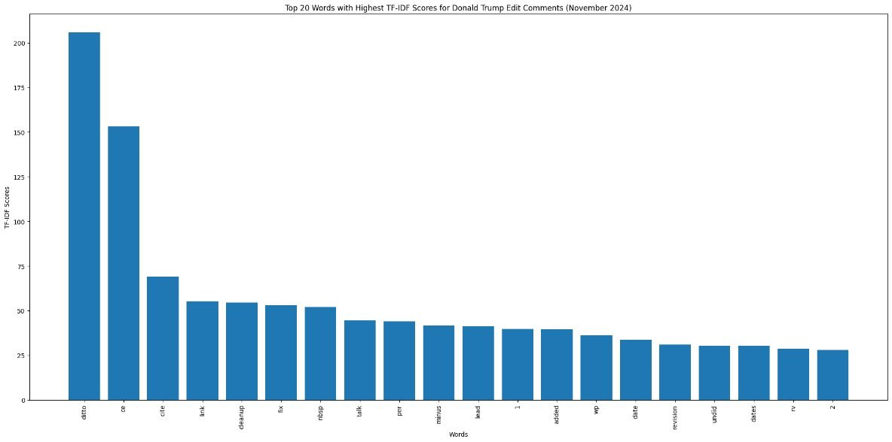
Donald Trump (Nov 2024)

Slide 28
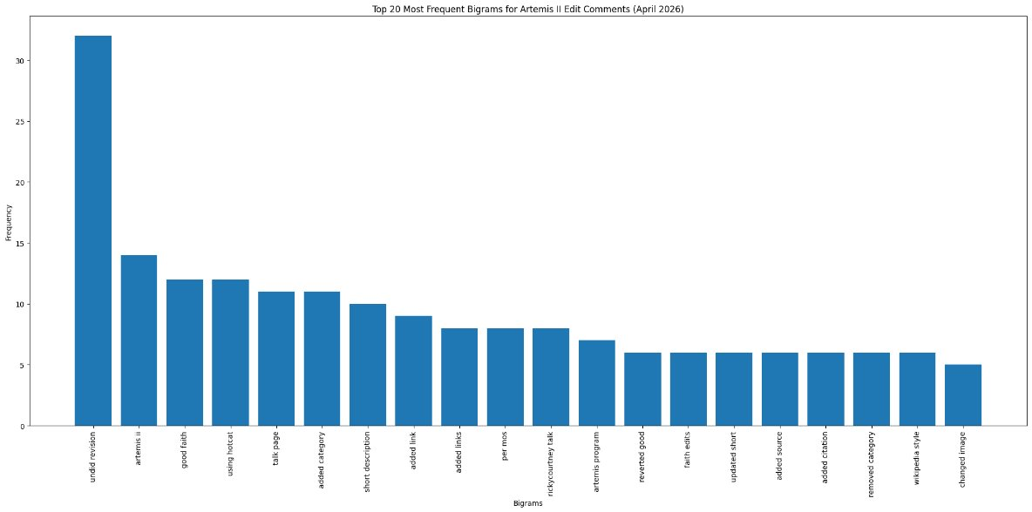
Artemis II (Apr 2026)

Slide 29
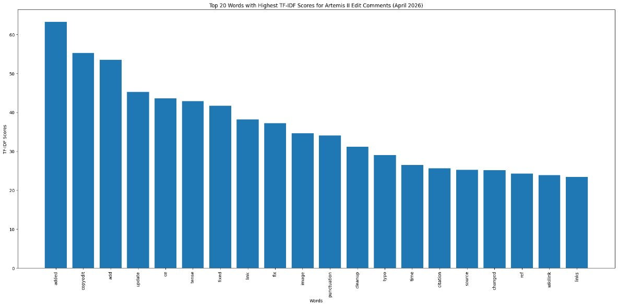
Artemis II (Apr 2026)

Slide 30
03
Challenges

Slide 31
Challenges
Finding Articles
Data Gathering
Many articles are under protection, complicating edit rates
  Had to assume what articles are 'controversial'
Edits are long and can range throughout an entire article
  Causes long compute time due to edit length

Slide 32
04
Updates

Slide 33
Updates
Analyzing Comments and Content
Article Finding
Analyze sentiment analysis further to identify any signs of 'raids'
Find words used when 'raids' occur
Analyze the edit rates in 'raids' to find patterns that can be generalized
Use found patterns to see whether or not it is possible to identify articles that:
  are currently 'raided'
  have a history of 'being raided'

